Slide 1
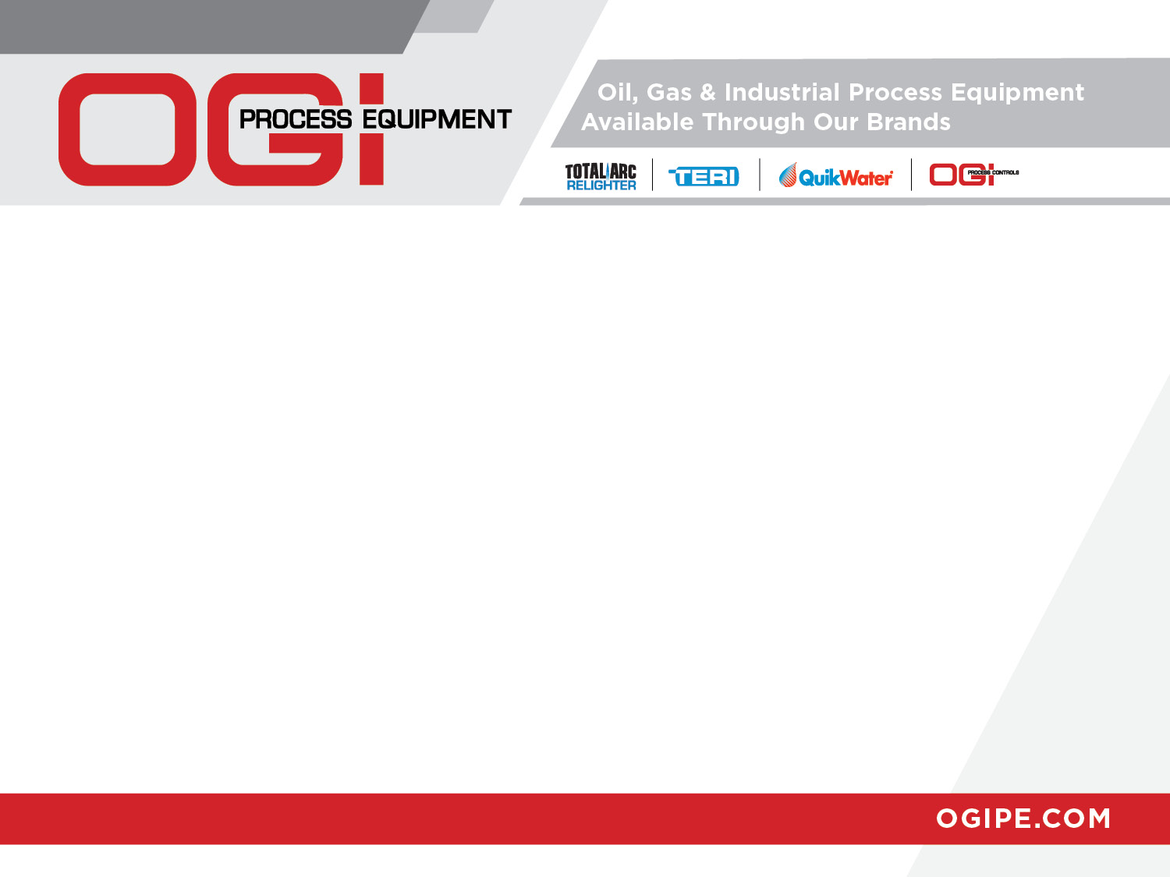


Slide 2
Line Heater Technologies
-
How to Gain Efficiency and
Operate Effectively

Slide 3

Line Heater Technologies
OUTLINE
Combustion
Combustion System Design
Notes:
OUTLINE
Combustion
Combustion Efficiency
Combustion System Design

Slide 4

Line Heater Technologies
Combustion
Combustion, or burning, is a rapid combination of Oxygen with a fuel, resulting in the release of heat
North American Combustion Handbook
AIR
IGNITION
FUEL
Notes:
Everything necessary for combustion to occur is contained in this match, it’s surroundings and on this strike plate. Once the match is drawn across the strike plate an everyday process of combustion is started.
The North American Combustion Handbook defines combustion as: “Combustion, or burning is a rapid combination of Oxygen with a fuel, resulting in the release of heat”

Slide 5
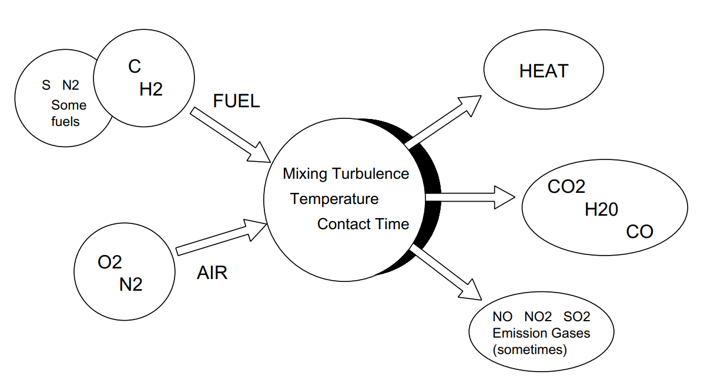
Line Heater Technologies
Combustion
Combustion Process
Chemical Reaction
Nothing is created or destroyed.
HEAT
Notes:
When we discuss Combustion Efficiency, we need to understand the combustion process to produce the best environment for combustion to occur
Combustion is a chemical reaction . . . With this process, we know that “Nothing is created or destroyed” in this process.
When we look at the combustion process, whatever enters the process is conserved through the reaction “=>” resulting in products of combustion and HEAT.
In out case, the HEAT associated with this reaction is what we are after.

Slide 6
Line Heater Technologies
Combustion
Combustion Process
Chemical Reaction
FUEL + AIR => PRODUCTS + HEAT
Basic Combustion Equation
CH₄ + 2O₂ + N₂ => CO₂ + 2 H₂O + N₂ + HEAT
HEAT
Notes:
For this example, FUELS are hydrocarbons, meaning they are composed primarily of carbon and hydrogen.
When these fuels are burned with the proper amount of AIR, carbon dioxide (CO2) and water (H2O) are the principle chemical products, formed from the reactants carbon and hydrogen in the fuel and oxygen (O2) in the air.
The simplest example of hydrocarbon fuel combustion is the reaction of methane (CH4), the largest component of natural gas, with O2 in the air.
When this reaction is balanced, or stoichiometric, each molecule of methane reacts with two molecules of O2 producing 1 molecule of CO2 and 2 molecules of H2O.
In an actual combustion processes, other products are often formed which are influenced by impurities in the fuel and combustion process.

Slide 7
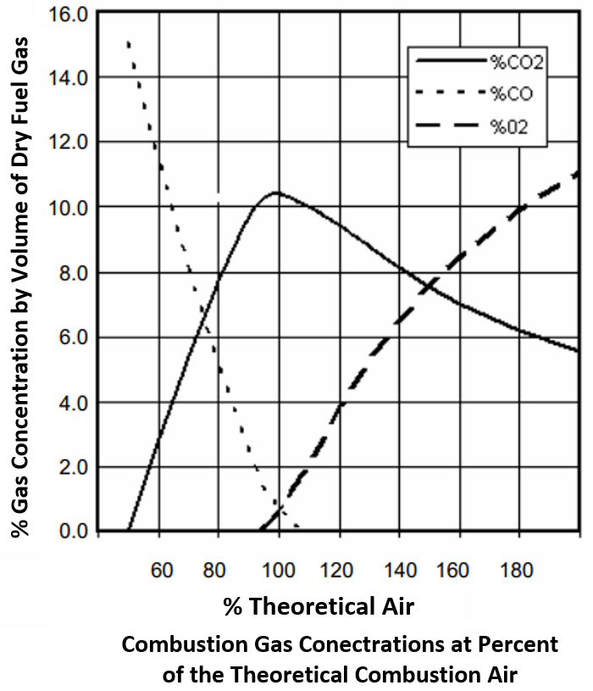
Line Heater Technologies
Combustion
Combustion Process - Theoretical
Fuel-Rich – NO Excess Air
Excess Air
Fuel-Rich
Excess
Air
Notes:
Here is a graph representing percent of Theoretical Air versus different productions of combustion which includes trends for % Carbon Dioxide, % Oxygen and % Carbon monoxide.
The area to the left of the 100% Theoretical Air vertical line where air combustion concentration are less than 100% is know as the Fuel-Rich region
The area to the left of the 100% Theoretical Air vertical line where combustion air concentration are greater than 100% is know as the Excess Air region
Let’s see what impact that combustion air concentrations have in fuel/air mixtures as illustrated on this graph.

Slide 8
Line Heater Technologies
Combustion
Combustion Process - Theoretical
100% Theoretical Air
Stoichiometric
Ratio
100% Theoretical Air results in no unburnt Fuel and no excess air.
Stoichiometric Combustion is obtained by mixing and burning the exact proportion of fuel and air so that nothing is left over but CO₂ and H₂O.
Fuel-Rich
Excess
Air
Notes:
The amount of combustion air supply necessary to consume all the fuel is know as 100% Theoretical Air. What’s interesting is that this amount of air only allows the fuel to be burned by does not provide effective complete combustion,
as seen by the remaining carbon monoxide.
Stoichiometric Combustion is obtained by mixing and burning the necessary concentration of combustion air with fuel, so no CO is created, and all that remains is CO₂ and H₂O.

Slide 9
Line Heater Technologies
Combustion
Combustion Process - Theoretical
Highest Theoretic Combustion Efficient
Highest Theoretic Combustion Efficiency occurs with only 5-10% Excess Air
  Minimal losses due to lowest Excess Air to produce complete combustion
Is this practical?
Fuel-Rich
Excess
Air
Notes:
Operating fuel/air concentration near Stoichiometric air supply region not only allow for complete, effective combustion, it also provide the benefit of operating with at the highest combustion efficiency. Depending on fuel composition, this Excess Air concentration typically lies in the range of 5-10% excess Air.
BUT . . . Is this practical?
To better understand HOW we an improve combustion performance and efficiency, we need to understand what causes incomplete combustion

Slide 10
Line Heater Technologies
Combustion
Combustion Process
#1
Products of Combustion
  Nitrogen (N₂)
  Carbon Monoxide (CO)
  Carbon Dioxide (CO₂)
  Oxygen (O₂)
  Water (H₂O)
  Balance made up of:
    Nitrogen Oxides (NO_{x})
    Sulfur Oxides (SO_{x})
Which of the above are the best indicators of good combustion?
Which of the above is commonly used to define complete combustion?
Notes:
When fuels, like natural gas, are burned, they typical create products of combustion include the following:
Nitrogen (N₂)
Carbon Monoxide (CO)
Carbon Dioxide (CO₂)
Oxygen (O₂)
Water (H₂O)
Balance made up of:
Nitrogen Oxides (NO_{x})
Sulfur Oxides (SO_{x})
. . . Remember that this being a CHEMICAL REACTION that nothing is created or destroyed.
. . . Therefore, the amount of Sulfur Oxides present is in the Products of Combustion is directly proportional to the amount Sulfur present in the Fuel being burned.
Of these flue gas constituents:
Which are the best indicators of good combustion
Carbon Monoxide Concentration
% Oxygen
Which is the one commonly used to define complete combustion?
Carbon Monoxide Concentration

Slide 11
Line Heater Technologies
Combustion
Combustion Process – What causes incomplete combustion (CO)?
  Insufficient Air Supply to the flame
Possible Reason:
  Blocked Air Supply
    Flame Arrestor Blocked
    Air Supply Louver Linkage
    Fire Tube Design
  Blocked Stack
    Stack Damper Position
    Infestation
  Down Drafting
    Wind
    Heater Installation Location
  Combustion System Design
  Operator Error / Tampering
Notes:
Just because we have met the Excess Air / Excess Oxygen require discussed earlier, doesn’t guarantee good combustion efficiency or that NO Carbon Monoxide will be produced.
SO . . What causes INCOMPLETE combustion and the production of Carbon Monoxide?
Insufficient Air Supply to the Flame.
some Possible Reason:
Blocked Air Supply
Flame Arrestor Blocked
Air Supply Louver Linkage
Fire Tube Design
Blocked Stack
Stack Damper Position
Infestation
Down Drafting
Wind
Heater Installation Location
Combustion System Design
Operator Error / Tampering

Slide 12
Line Heater Technologies
Combustion
Combustion Process – What causes incomplete combustion (CO)?
  Insufficient Air Supply to the flame
  Cooling of the flame temperature (Quenching)
    Flame Impingement
    Insufficient time to burn
  Poor Mixing of Fuel and Air
    Over drafting
    Too Much Air
Possible Reason:
  Fuel Supply changes
    Fuel Supply Pressure
    Burner Orifice change
    Fuel Composition
  Combustion Chamber Design
    Stack and Flame Arrestor
    Burner too large / small
    Refractory Design (FD)
    Fire Tube Flux Rate
    Fire Tube Heat Density
  Operator Error / Tampering
Notes:
Additional possible causes include:
Cooling of the flame temperature (Quenching)
Flame Impingement
Insufficient time to burn
Poor Mixing of Fuel and Air
Over drafting
Too Much Air ( HIGH EXCESS O₂ readings from Combustion Analyzer.
Possible Reason:
Fuel Supply changes
Fuel Supply Pressure
Burner Orifice change
Fuel Composition
Combustion Chamber Design
Stack and Flame Arrestor
Burner too large / small
Refractory Design (FD)
Fire Tube Flux Rate
Fire Tube Heat Density
Operator Error / Tampering

Slide 13
Line Heater Technologies
Combustion
Combustion Process – Air
Combustion Process
Optimal Combustion Efficient
Why Excess Air?
  Ensures Complete Combustion throughout the combustion chamber
    5% - 10% Excess Air
What Impacts Air Supply?
  Ambient Air Temperature
  Humidity (Dew Point)
  Elevation (feet above Sea Level)
Optimal
  15% - 25% Excess Air
  ~3% - ~5% O₂
Highest Theoretic Combustion Efficient
Excess
Air
Notes:
So far, we’ve seen that much of the combustion performance and emissions are dictated by providing the appropriate amount of AIR.
Why Excess Air?
As discussed previously, a minimum amount of air flow is required to ensure complete combustion, not only at the flame front but throughout the combustion chamber.
What impacts air supply to the combustion chamber?
Since the supply of air to and through the combustion chamber is dictated by the ability for the stack to draft properly, Ambient air influences like Air Temperature, Humidity and the heater’s installed elevation need to be accounted for when designing this combustion system and stack.
When all the conditions are properly accounted for, the Optimal air flow design can be meet of ~15 to 25% Excess Air or ~3% to 5% O2.
Knowing the impact of air flow on the combustion process, we need to understand how the burner uses and controls the available air to produce complete combustion.

Slide 14

Line Heater Technologies
Combustion
Combustion Process – Air
Primary Air Source:
Drawn by Venturi Type, partial pre-mix burners for Natural Draft
Provides the larger percentage of the air for combustion,
Controls the amount of fuel that can be burned
  Support flame stability at the burner nozzle / head
Primary Air:
Primary Air
Intake
Fire Tube
Natural Gas
Notes:
Venturi type burners, commonly used in natural draft applications.
The primary air supply for venturi burner is drawn in to the burner as the result of negative pressure in the burner mixing head caused by the flow of fuel into the burners venturi. The amount of air flow is controlled by the fuel supply pressure and the burners air shutter position.
Primary air provides the larger percentage of the combustion air needed for complete combustion as well as supports flame stability at the main burner nozzle.

Slide 15
Line Heater Technologies
Combustion
Combustion Process – Air
Secondary Air Source:
Secondary Air
  Supported through the stack draft
  Improves combustion efficiency
  Provides the air necessary throughout the length of the fire tube to support burning the fuel completely
Fire Tube
Secondary
Air Dampers
Notes:
Secondary air is an essential part of ensuring complete combustion. As shown here, this air is the free air that flows through the combustion chamber dictated by the stack draft and impacted by flow air flow dampers located in the air supply or the stack.
Secondary Air improves combustion efficiency AND provides the air necessary throughout the length of the fire tube to support complete combustion.

Slide 16
Line Heater Technologies
Combustion System Design
Combustion Efficiency
Products of Combustion
  Nitrogen (N₂)
  Carbon Monoxide (CO)
  Carbon Dioxide (CO₂)
  Oxygen (O₂)
  Water (H₂O)
  Balance made up of:
    Nitrogen Oxides (NO_{x})
    Sulfur Oxides (SO_{x})
Stack Temperature
Fuel Gas Flow Rate
Which of the above are the best indicators of combustion efficiency?
Notes:
Knowing that we have indicators which help us understand how effective our combustion process is, we now need to focus on the Efficiency of absorbing “HEAT” energy from the combustion process. . . .
To completely understand the Efficiency of the Combustion Systems, we also need to note the
Stack Temperature
Fuel Gas Flow Rate
. . . These values allow us to understand how effective the combustion system design is removing available energy from the fuel being burned.
Which are the best indicators of combustion Efficiency?
Oxygen (O2)
Stack Temperature

Slide 17
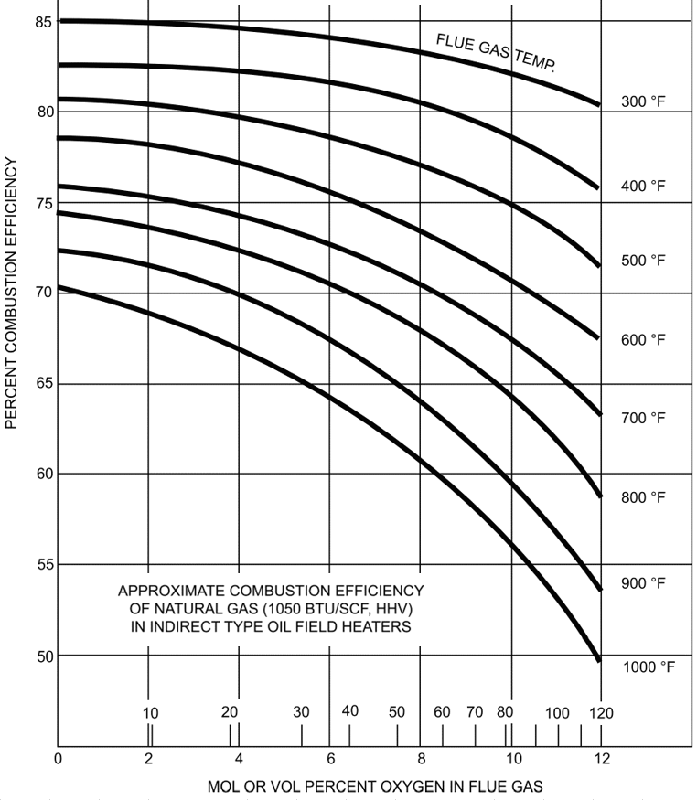
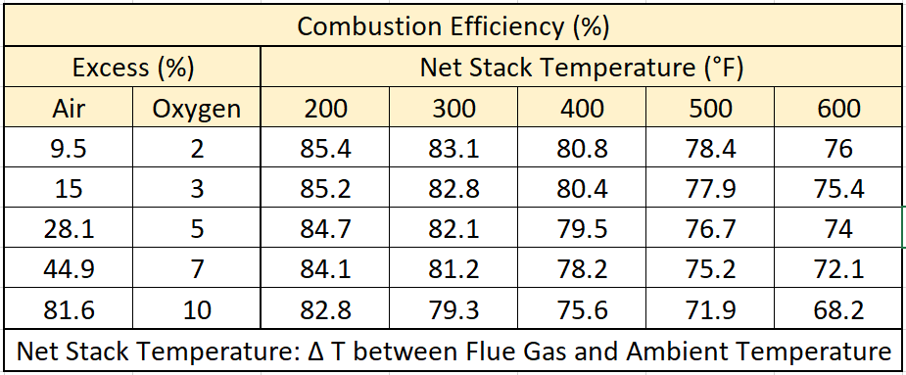
Line Heater Technologies
Combustion System Design
Forced Draft
Natural Draft
Combustion Efficiency
S
Indirect Fired, Natural Draft (Typical)
  Minimum requested – ~65%
  Maximum – ~83%
Indirect Fired, Force Draft (Typical)
  Minimum – ~75%
  Maximum – ~87%
S
W
W
Notes:
Combustion efficiency is a measure of how effectively the heat content of a fuel is transferred into usable heat.
The stack temperature and oxygen concentrations in the flue gas are primary indicators of combustion efficiency.
. . . Here is a table and graph representing combustion efficiency for natural gas burners.
Indirect Fired, Natural Draft (Typical)
Minimum requested – ~65%
Maximum – ~83%
. . . . Here we can see the impact of summer (“S”) and winter (“W”) operation.
. . . . Cooler ambient temperatures associated with winter operation will cause a Natural Draft combustion system to draft harder causing stack temperatures to rise and over-drafting to occur, raising the O2 Percentage.
. . . . This can be seen in both the Combustion Efficiency Table and Graph
Indirect Fired, Force Draft (Typical)
Minimum – ~75%
Maximum – ~87%
. . . . Here again we can see the impact of summer (“S”) and winter (“W”) operation.
. . . . Cooler ambient temperatures causes a denser air supply to the burners blower which will result in an increased O2 percentage and slightly higher stack temperatures.
. . . . Because the forced draft burner air flow is limited by it’s blower, over-drafting is limited.

Slide 18
Line Heater Technologies
Combustion System Design
Forced Draft
Natural Draft
Combustion Efficiency
S
How to best improve Combustion performance?
  Controlling Flue Gas Temperature
  Controlling Oxygen Concentration in Flue gas
  Ensure Fuel / Air mixing prior to combustion
  Condensing water vapor out of flue gases
    Where does this happen?
    Is this Practical?
W
Lower Stack Temp
Lower Excess %O₂
Notes:
How to best improve Combustion Performance?
Controlling Flue Gas Temperature
Controlling Oxygen Centration in Flue gas
Ensure Fuel / Air mixing prior to combustion
Condensing water vapor out of flue gases
Where does this happen?
. . . . We discussed previously that the water vapor will either be rejected to atmosphere through the stack as water vapor or condense out as a liquid from the combustion chamber drain.
Is this Practical? . . . To add the additional combustion chamber enhancements to condense the water out of the flue gas.
Less Practical for Natural Draft combustion
More practical for Forced Draft
. . . . It’s important to remind everyone that we are talking about ~11gallons of available water for every MMBtu of natural gas burned. Therefore, it will be important to have a plan to handle the amount of condensed water being drained a combustion system.

Slide 19
Line Heater Technologies
Combustion System Design
Combustion Efficiency
Combustion Efficiency - Heat Release to Process
Energy available in the Fuel being consumed
  GROSS versus NET Heating Value
  For Natural Gas
    Gross Calorific valve (Higher Heating Valve – HHV): 1006 Btu/cf
    Net Calorific Value (Lower Heating Value – LHV): 906 Btu/cf
  Best achievable combustion efficiency = ~90%
    Varies with fuels burned
  Difference – Energy lost when water vapor is released with the Flue Gas.
Water as Vapor
Net Calorific Value (LHV)
Nat. Gas
CH₄
Combustion
Products of
Combustion
Water as Liquid
Gross Calorific Value (HHV)
Oxygen
O₂
Fuel + Air
Mixing
Notes:
When we look closer at the definition of Combustion Efficiency, we find that it is
“the measure of how effectively the heat content of a fuel is transferred into usable heat. “ In our case, we need to understand how to improve the Heat Release to Process for the Energy available in the fuel being consumed.
Basically, a comparison of the GROSS energy available versus the NET amount of energy removed during the combustion process.
For Natural Gas the
Gross Calorific valve (Higher Heating Valve – HHV): 1006 Btu/cf
Net Calorific Value (Lower Heating Value – LHV): 906 Btu/cf
. . . . . Therefore the “Best achievable combustion efficiency = ~90%” without condensing any water out of the flue gas
This “Varies with fuels burned” for example this efficiency increases to ~92% with Propane.
Difference – Energy lost when water vapor is released with the Flue Gas.

Slide 20
Line Heater Technologies
Combustion System Design
Combustion Efficiency - Heat Release to Process
Energy available in the Fuel being consumed – NATURAL DRAFT
Available Energy to process =
  Gross Burner Input (HHV)
      Hot Exhaust gases
      Losses in Heater Shell
Heat Loss from Stack: 20-33%
Stack Temp: 250°F – 1000°F
% O2: 3% - 10%
1-4% Shell Losses
Available Energy to Process
65-77%
Indirect Fired
Water Bath Heater
100% Energy Input
Gross Burner Input
(Higher Heating Value)
Notes:
Let’s look at the expected combustion efficiency for an Indirect Fire Water Bath heater using Natural Draft burner.
To review . . . the combustion efficiency is a measure of how effective the fuels energy content is transferred into usable heat to the process
The stack temperature and flue gas oxygen concentrations are primary indicators of combustion efficiency.
Available Energy to process =
100% Energy Input from the Fuel or the Gross Burner Input (HHV)
- Energy lost from the stack via “Hot Exhaust gases”
- Energy “Losses in Heater Shell”
Resulting in a 65% to 75% available energy to the process.

Slide 21
Line Heater Technologies
Combustion System Design
Combustion Efficiency - Heat Release to Process
Energy available in the Fuel being consumed – FORCED DRAFT
Available Energy to process =
  Gross Burner Input (HHV)
      Hot Exhaust gases
      Losses in Heater Shell
Heat Loss from Stack: 13-25%
Stack Temp: 300°F – 550°F
% O2: 3% - 6%
1-4% Shell Losses
Available Energy to Process
72-85%
Indirect Fired
Water Bath Heater
100% Energy Input
Gross Burner Input
(Higher Heating Value)
Notes:
For Forced Draft the same losses exist, but because of the improved fuel/air mixture control under varying ambient conditions,
The Losses through the shell remain the same.
the stack losses are reduced
Resulting in a 72% to 85% available energy to the process.
These efficiencies can improve when more to water vapor is condensed out of the Flue Stack Gases.
Note that the Stack excess %O2 will vary for Forced Draft combustion system depending on the type of burner used.
Those represented here are for Standard FD Burners.
Low NOx and Ultra-Low NOx burners require additional Excess %O2 to reduce the NOx produced.
Relatively this excess %O2 will increase to ~6% to as much as 8% O2.

Slide 22
Line Heater Technologies
Combustion System Design
Combustion Efficiency - Heat Release to Process
What did we learn (so far) ?
  The more efficient the design of the combustion chamber and the combustion system, the more available energy can be absorbed into the downstream process.
    Air supply rate too high
      Increased sensible heat loss
    Air supply too low
      Incomplete combustion resulting in unspent fuel being exhausted
    High Stack Temperature
      Increased Sensible heat loss
      Reduced combustion efficiency
Notes:
What did we learn?
The more efficient the design of the combustion chamber and the combustion system, the more available energy can be absorbed into the downstream process
Air supply rate too high
Increased sensible heat loss
Air rate too Low
Increased heat loss due to incomplete combustion
High Stack Temperatures
Increased Sensible heat loss

Slide 23
Line Heater Technologies
Combustion System Design
Application Requirements
Important information to know when configuring a combustion system
  Fuel being burned
    Gross Btu/hr. (Btu/cf)
    Specific Gravity (lbs./cf)
  Burner Firing Rate
  Elevation of heater installation (feet above sea level)
  Ambient Air Temperature and humidity
  Combustion chamber design
    Flux rate
    Combustion Density
    Flow losses
    Flame Arrestor design and options
  Combustion Emission Requirements (occasionally defined by Client)
Notes:
Important information to know when setting-up/tuning a combustion system
Fuel being burned
Gross Btu/hr. (Btu/cf)
Specific Gravity (lbs./cf)
Burner Firing Rate
Elevation of heater installation (feet above sea level)
Ambient Air Supply Temperature and humidity
Combustion chamber design
Flux rate
Combustion Density
Flow Losses
Flame Arrestor Design and Options
Combustion Emission Requirements (occasionally defined by Client)

Slide 24
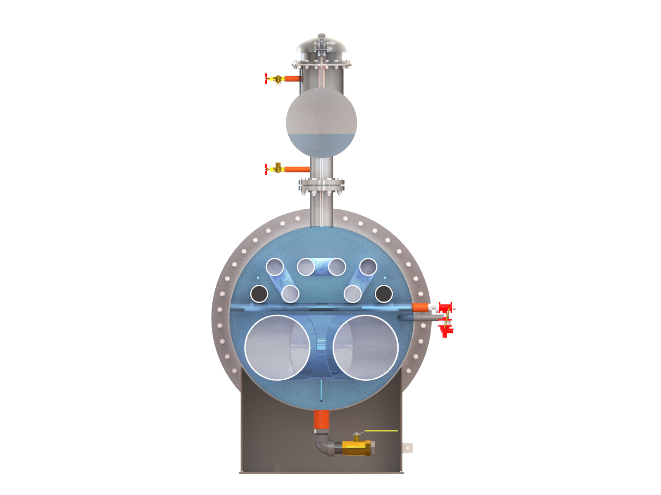
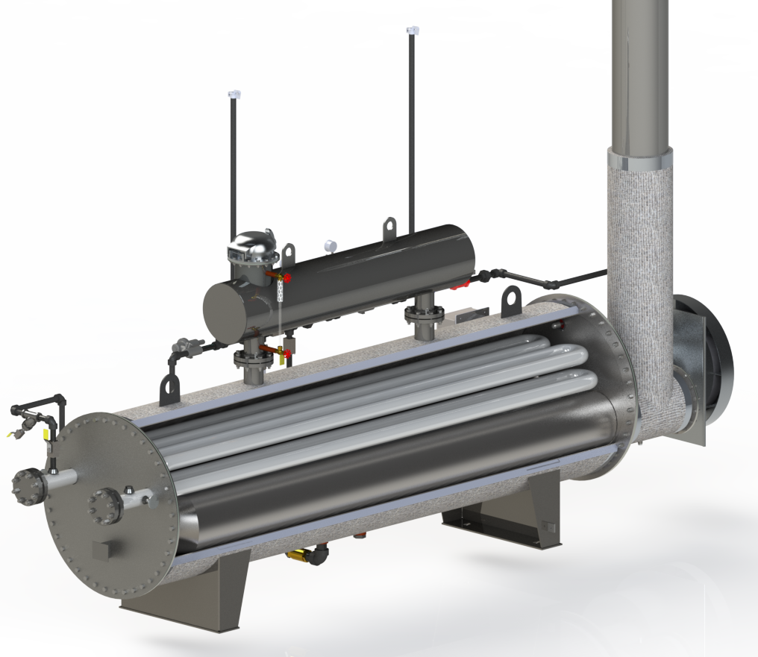
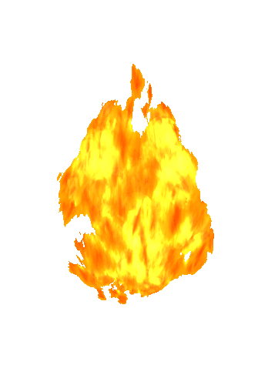
Line Heater Technologies
Combustion System Design
Application Requirements
    Convective Current
    Heater Bath Media
      Ethylene Glycol/Water
      Propylene Glycol/Water
Notes:
Natural Convention creates fluid circulation within the vessel due to the density variation between the hot and cold bath fluid
Bath fluid transfers heat energy from the fire tube to the process coil which transfer energy to the process fluid inside the coil tubes

Slide 25
Line Heater Technologies
Combustion System Design
Application Requirements
  Heater Bath Media Ethylene Glycol Propylene Glycol
    Typical Composition: 40% or 50% Glycol Volume to Water
    Heat Transfer: Good Heat Transfer Poor Heat Transfer
    Thermal Conductivity* k = 0.241 Btu/hr.ft.°F k = 0.210 Btu/hr.ft.°F
    Specific Heat* Cp = 0.842 Btu/lb.°F Cp = 0.886 Btu/lb.°F
    Environmental: Less Friendly More Friendly
  * 50% glycol by volume in water at 150°F media temperature
Notes:
Glycol raises the boiling point of water
Important to understand the difference between thermal conductivity and specific heat
Thermal conductivity – how much energy can be absorbed
Specific heat – how much energy is required to raise the temperature (approximately 1 degree)
Ethylene can absorb more energy and requires less energy to raise the temperature

Slide 26
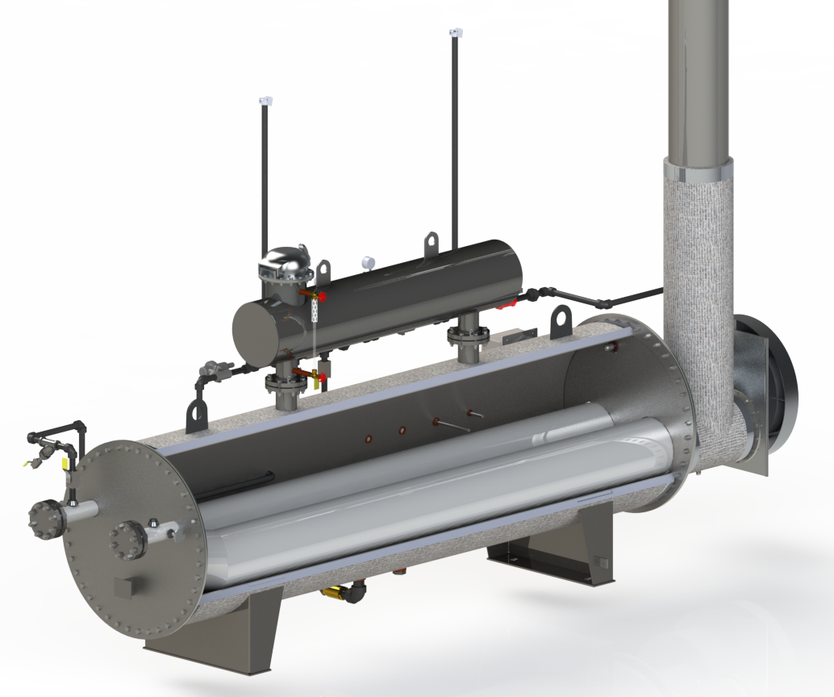


Line Heater Technologies
Combustion System Design
FIRE TUBE DESIGN:
FLUX RATE (avg): BTU/hr-ft²
  Net Heat input (Duty) / SA _{FT}
  a.k.a. . . . Heat intensity
  Gas Processors Suppliers Assoc. (GPSA) Std:
    Water: 10,000 to 13,000Btu/hr-ft²
    50% Ethylene: 8,000 to 10,000Btu/hr-ft²
  Common Flux rate limits
    (Dependent on Glycol Type & Concentration)
    Ethylene - 7,000 to 10,500 Btu/hr-ft²
    Propylene - 6,000 to 9,500 Btu/hr-ft²
Application Requirements
  Heater Bath Media
Notes:
Everything has a heat absorption rate
When an items heat absorption rate is exceeded, it burns.
Same happens to glycol in the heater

Slide 27
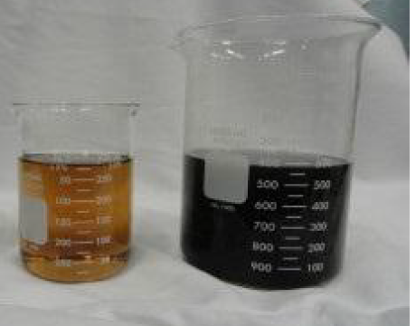
Line Heater Technologies
Combustion System Design
FIRE TUBE DESIGN:
ISSUES WITH HIGH FLUX RATES:
    Increased Maintenance Cost
      Glycol Breakdown:
        Scorching / Coking
        Rapid loss of inhibitors
        Acidic bath media
      Fire tube hot spots / Failure
      Higher bath evaporation rate
    High Stack Temperatures
    Reduced combustion efficiency
Application Requirements
  Heater Bath Media
  Fresh Glycol Scorched Glycol
Notes:
Glycol raises the boiling point of water

Slide 28
Line Heater Technologies
Combustion System Design
FIRE TUBE DESIGN:
HEAT DENSITY (avg): BTU/hr-in²
    Heat released through the cross-sectional area of the fire tube
    Gross Heat input / XA _{FT}
  Max. (12,500 Btu/hr-in²)
Application Requirements
  Heater Bath Media
Notes:
Flux rate is the net transfer of energy
Too much energy will result in heat traveling all the way through the firetube and out the stack

Slide 29
Line Heater Technologies
Combustion System Design
FIRE TUBE DESIGN:
ISSUES WITH HIGH HEAT DENSITY:
    Incomplete combustion
      High stack emissions
    Reduced combustion efficiency
    High Stack Temperatures
    Increased Maintenance Cost
Application Requirements
  Heater Bath Media
Notes:
Incomplete combustion creates high CO
Too much energy in results in not all energy being absorbed
A heater with higher heat input can actually underperform in comparison to a heater with lower heat input

Slide 30
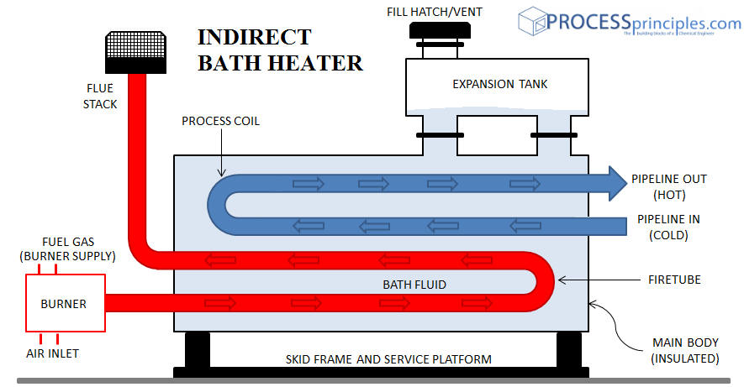
Line Heater Technologies
Combustion System Design
Application Requirements
Combustion Systems design is a balance of thermal and fluid losses versus the ability to draw air into the combustion system.
Losses to be considered:
  Flame Arrestor Design
  Combustion chamber shape
  Obstruction,
    burner, pilot, etc.
  Chamber transition
  Air Control devices
  Stack
  Stack Cap
FLAME
ARRESTOR
Notes:
Combustion Systems design is a balance of thermal and fluid losses versus the ability to draw air into the combustion system.
Losses to be considered:
Flame Arrestor Design
Combustion chamber shape
Obstruction,
burner, pilot, etc.
Chamber transition
Air Control devices
Stack
Stack Cap
Evaluation of the thermo and fluid dynamics associated with the combustion system provides the best view of the potential efficiency that can be achieved for a specific application
For natural draft combustion, one of the keys lies in the Stack Design

Slide 31
Line Heater Technologies
Combustion System Design
Application Requirements
Stack Draft Design –
  Stack Draft is a relationship between the average Flue Gas density in the Stack and ambient air density, and the difference in elevation between stack discharge and the combustion system air supply
Stack Draft must efficiently overcome the losses in the combustion system to effectively sustain complete combustion through varying ambient conditions
FLAME
ARRESTOR
Notes:
Stack Draft Design –
Stack Draft is a relationship between the average Flue Gas density in the Stack and ambient air density, and the difference in elevation between stack discharge and the combustion system air supply
Stack Draft must efficiently overcome the losses in the combustion system to effectively sustain complete combustion through varying ambient conditions

Slide 32
Line Heater Technologies
Combustion System Design
Application Requirements – Stack Performance
Important information to know when configuring a combustion system
  Fuel being burned
    Gross Btu/hr. (Btu/cf)
    Specific Gravity (lbs./cf)
  Burner Firing Rate
  Elevation of heater installation (feet above sea level)
  Ambient Air Temperature and humidity
  Combustion chamber design
    Flux rate
    Combustion Density
    Flow losses
    Flame Arrestor design and options
  Combustion Emission Requirements (occasionally defined by Client)
Which of the above impacts Stack Draft Performance?
Which of the above will cause Stack Draft to vary the most?
Notes:
Revisiting the list of important data necessary to ensuring we a successful combustion chamber design was presented earlier
Which of the above impacts Stack Draft Performance?
A significant amount of this data is essential
Which of the above will cause Stack Draft to vary the most?
Ambient Air Supply Temperature and humidity
Though the others are important in sizing the combustion chamber, flame arrestor and stack, the greatest performance impact to overcome in this design is the impact of ambient temperature change.

Slide 33
Line Heater Technologies
Combustion System Design
Natural Draft
Application Requirements
Typical Stack performance
#1: Summer operation at 1000’ ASL
#2: Summer operation at 500’ ASL
#3: Winter operation, same stack temp
#4: Winter operation, typical stack temp
1
2
3
4
Heater Duty: | 750MBtuh, 12" Diameter Stack
Scenario | 1 | 2 | 3 | 4
Elevation (ft) | 1000 | 500 | 1000 | 1000
T)Stack (°F) | 755 | 755 | 755 | 855
T)Amb (°F) | 90 | 90 | -10 | -10
%O2 | 3.42 | 3.79 | 7.15 | 7.31
Air Drafted (scfh) | 12,459 | 12,722 | 15,547 | 15,723
Notes:
To illustrate the impact of elevation and ambient temperature and stack temperature, lets graph the resulting performance from an actual heater design
Typical Stack performance
#1: Summer operation at 1000’ ASL
#2: Summer operation at 500’ ASL
#3: Winter operation, same stack temp
#4: Winter operation, typical stack temp
NOTE that
In appropriate size stack, too HIGH or LARGE in diameter,
Stack will overdraft during very cool ambient temperature operations.
Air Rate Too high
Increased sensible heat loss – High Stack Temperatures.
HIGH O2
In appropriate size stack, too LOW or SMALL in diameter,
Stack will not draft enough
Stack will overdraft during very cool ambient temperature operations.
Air Rate too Low
Increased heat loss due to incomplete combustion
Flue Gas Temp too High
Increased Sensible heat loss

Slide 34
Line Heater Technologies
Combustion System Design
Misconceptions about combustion performance/efficiency:
  Different burners in the same combustion chamber will produce consistency in combustion efficiency
– NO
While different types of natural draft burners are more effective at entraining primary air prior to combustion, the effects of ambient temperature changes will continue to be an overwhelming influence on stack draft performance resulting in reduced efficiency during colder burner operation.
FLAME
ARRESTOR
Notes:
Misconceptions about combustion performance/efficiency:
Different burners in the same combustion chamber will produce consistency in combustion efficiency
- NO
While different types of natural draft burners are more effective at entraining primary air prior to combustion, the effects of ambient temperature changes will continue to be an overwhelming influence on stack draft performance resulting in reduced efficiency during colder burner operation.

Slide 35
Line Heater Technologies
Combustion System Design
Misconceptions about combustion performance/efficiency:
  Different burners in the same combustion chamber will produce consistency in combustion efficiency – NO
  Fixed Secondary air control produced consistent combustion efficiency
– NO
Fixed secondary air control and stack dampers are good for the ambient conditions they are set and will require seasonal adjustment to maintain good performance during a range ambient operating temperatures.
Stack dampers – Summer/winter positions
FLAME
ARRESTOR
Notes:
2. Fixed Secondary air control produced consistent combustion efficiency
- NO
Fixed secondary air control and stack dampers are good for the ambient conditions they are set and will require seasonal adjustment to maintain good performance during a range ambient operating temperatures.
Stack dampers – Summer/winter positions
Stack dampers provided with OGI stacks, have stops that will limit the closing position of the damper, intended for shoulder month operation.

Slide 36
Line Heater Technologies
Combustion System Design
Misconceptions about combustion performance/efficiency:
  Different burners in the same combustion chamber will produce consistency in combustion efficiency – NO
  Fixed Secondary air control produced consistent combustion efficiency – NO
  Modulation of an atmospheric injection type burner versus 100% ON/OFF control produces good efficiency throughout operating range
– NO
Though modulation provides variable heat (fuel gas) input to the combustion chamber, the burner best performance is at the 100% design point of the burner sizing.
Additionally, reduced burner input causes the stack to overdraft.
FLAME
ARRESTOR
Notes:
3. Modulation of an atmospheric injection type burner versus 100% ON/OFF control produces good efficiency throughout operating range
- NO
Though modulation provides variable heat (fuel gas) input to the combustion chamber, the burner best performance is at the 100% design point of the burner sizing.
Additionally Reduced fuel gas flow operation will cause the stack and combustion system to overdraft losing much of the heat energy up the stack.

Slide 37
Line Heater Technologies
Combustion System Design
What can we gain from what we’ve learned:
  Combustion Efficiency is something that is engineered for each application.
  Combustion Efficiency is not defined by the burner or stack, but is inclusive of the complete combustion system design
  Combustion system designs need to provide flexibility for changing seasons.
FLAME
ARRESTOR
Notes:
What have we learned?
Combustion Efficiency is something that is engineered for each application.
Combustion Efficiency is not defined by the burner or stack, but is inclusive of the complete combustion system design
Combustion system designs need to provide flexibility for changing seasons.

Slide 38
Line Heater Technologies
Questions?
Notes:
QUESTIONS?

